Slide 1
Test Driven Development

Slide 2
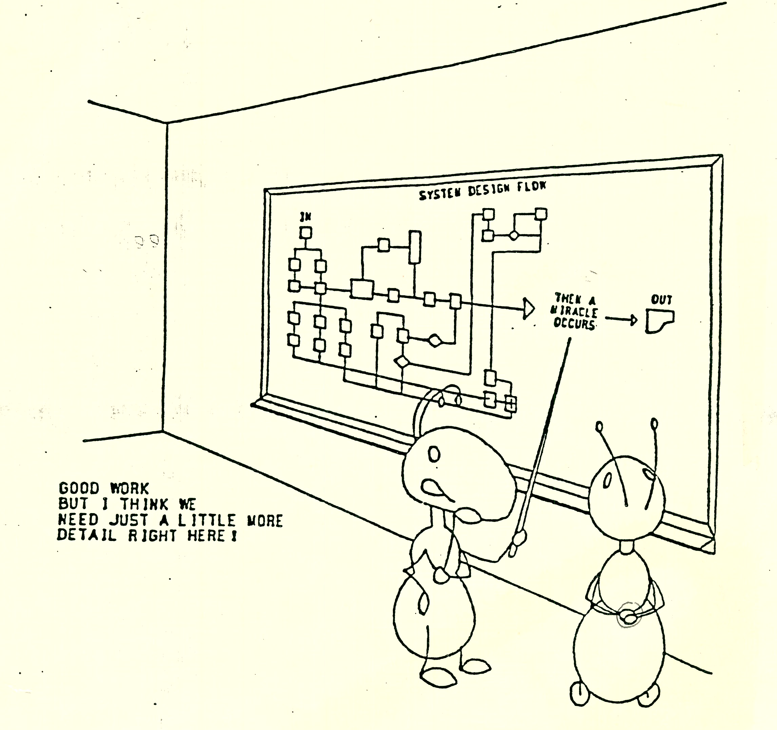
The Nature of our Problem

Slide 3
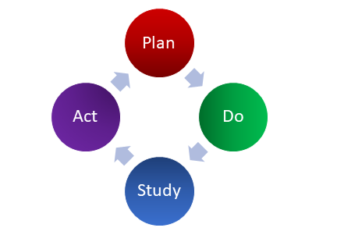
Test Driven Development?
First write a test that fails before you write new functional code
is a programming practice
is a development technique where you must

Slide 4
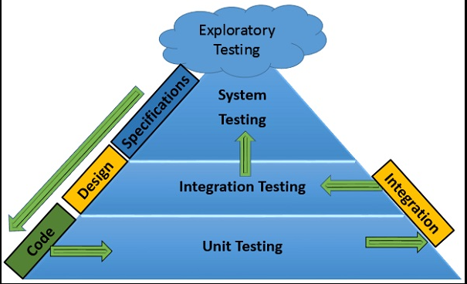
Testing Pyramid

Slide 5
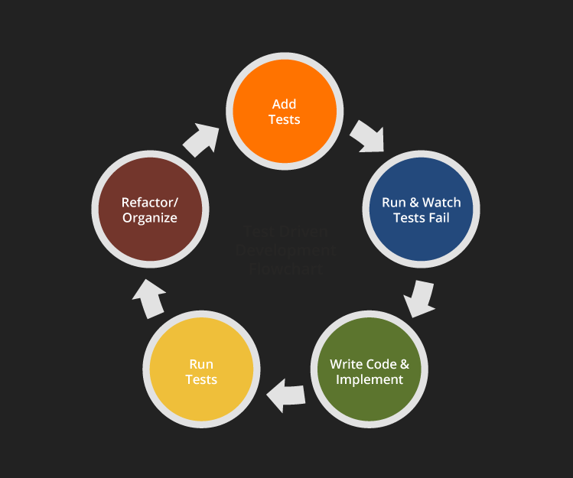
How it should work?
Think about what could be a reasonable test to verify compliance with the requirement.
Write the test before writing the code. Of course, the test will fail,
and that’s ok.
Keep things simple.
Then, write only the minimally necessary code to make the test pass.
This is a process of discovery; as you identify possible improvements,
refactor your code relentlessly to implement them.
Build, keep, and frequently run your cumulative collection of tests.

Slide 6
Characteristics
Test specific aspects of a functionality
Execute rapidly
Independent of each other
Independent of the surrounding environment
Independent of execution order
Automated

Slide 7
Green Field Projects
TDD operates with four pairs of strategies:
Details vs. the “big picture”
Uncertain territory vs. the familiar
Highest values vs. the low-hanging fruits
Happy paths vs. error situations.

Slide 8
Legacy Code
Identify the change point in the legacy code
Identify an inflection point
Cover the identified inflection point
Break internal dependencies
Break external dependencies
Write tests
Make changes
Refactor covered code

Slide 9
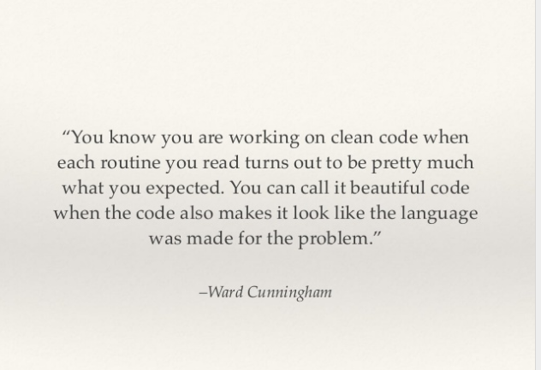

Slide 10
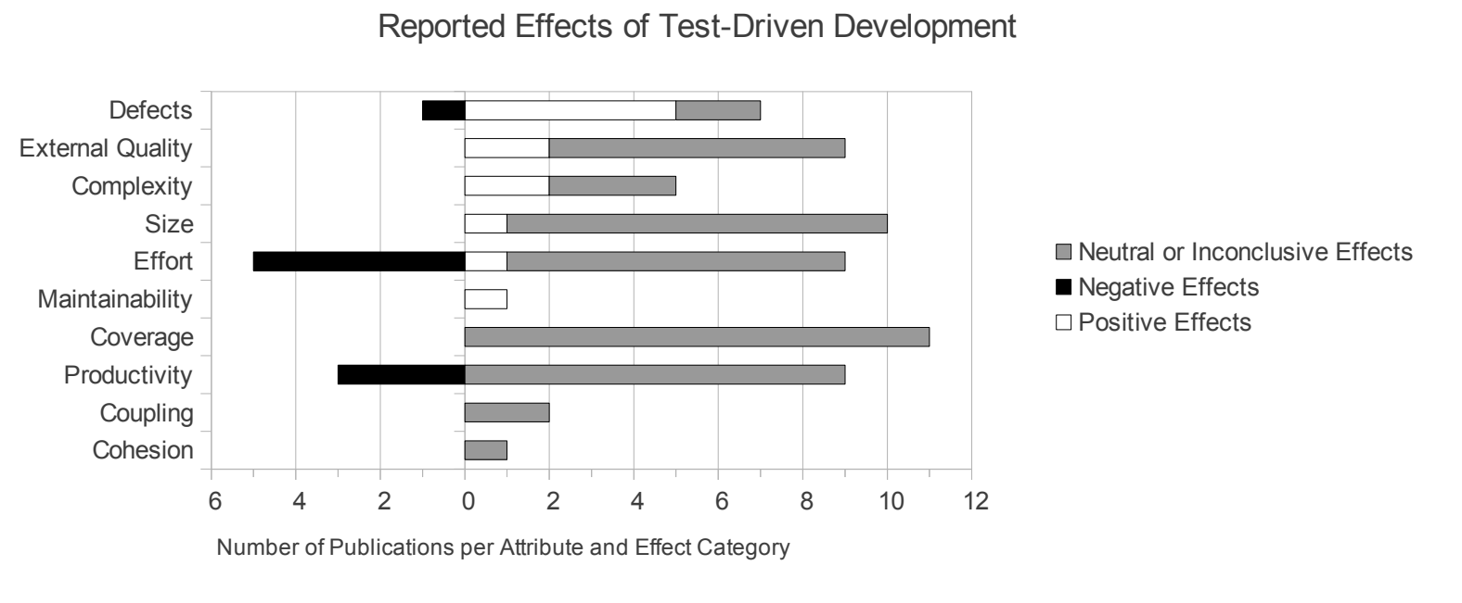
Effects of TDD

Slide 11
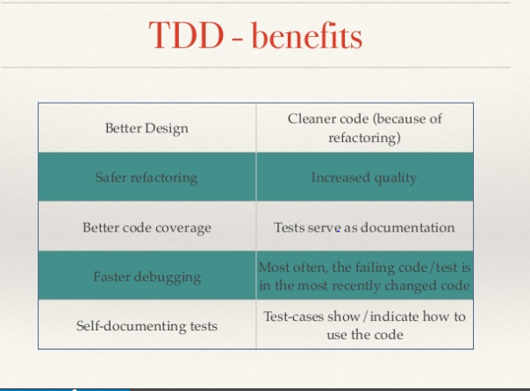

Slide 12
https://www.youtube.com/watch?v=O-ZT_dtlrR0
https://www.youtube.com/watch?v=T38L7A0xP-c
https://www.youtube.com/watch?v=uGaNkTahrIw
https://www.youtube.com/watch?v=O-ZT_dtlrR0 - Java testing framework.
https://www.youtube.com/watch?v=dWayn0QsJr8

Slide 13
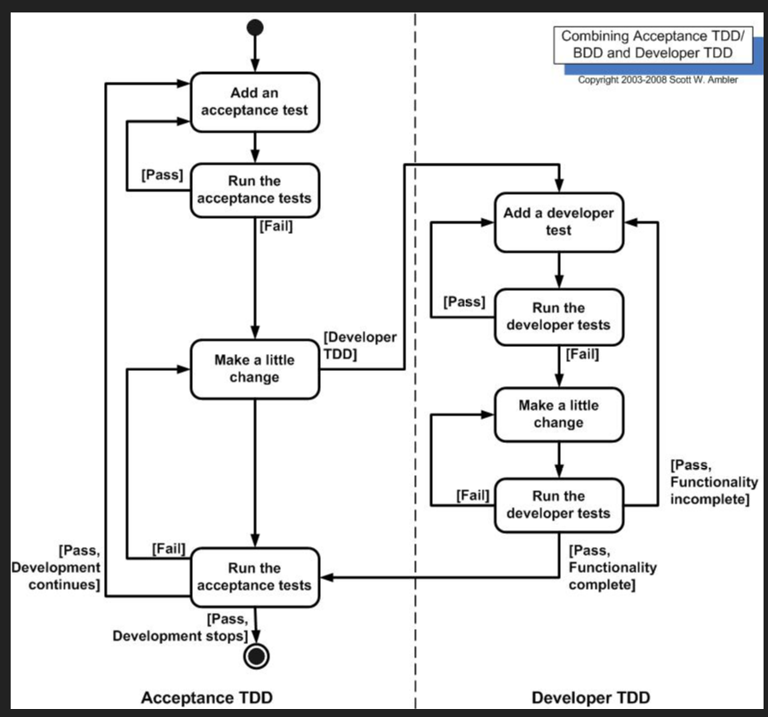
ATDD v/s TDD
Acceptance TDD (ATDD). With ATDD you write a single acceptance test, or behavioral specification depending on your preferred terminology, and then just enough production functionality/code to fulfill that test. The goal of ATDD is to specify detailed, executable requirements for your solution on a just in time (JIT) basis. ATDD is also called Behavior Driven Development (BDD).
Developer TDD. With developer TDD you write a single developer test, sometimes inaccurately referred to as a unit test, and then just enough production code to fulfill that test. The goal of developer TDD is to specify a detailed, executable design for your solution on a JIT basis. Developer TDD is often simply called TDD.

